Slide 1
Jean Monnet Chair Small Area Methods for Monitoring of Poverty and Living conditions in EU (SAMPL-EU)
Lecture 2: measuring poverty,
welfare indicators, issues on survey design
http://sampleu.ec.unipi.it

Slide 2
Definition of Poverty
...and Living Conditions

Slide 3
Measuring Poverty
The first step in measuring poverty is defining an indicator of welfare such as income or consumption per capita.
Information on welfare is derived from survey data.
Good survey design is important.
^{[1]} EU projects: SAMPLE, AMELI, Eframe, INGRID; World Bank, United Nations
^{[2]} Betti G, Lemmi A (2014) Introduction. In: Betti G, Lemmi A (eds) Poverty and Social Exclusion: New Methods of Analysis, London: Routledge., pp 1–6

Slide 4
…be aware
Indicator of welfare such as income or consumption per capita comes from National Accounts and should be in coherence with them and with the principles adopted by the European Statistical System.
^{[1]} reference: Lectures by Luigi Biggeri
^{[2]} principal financial instruments to support Member States in their fight against poverty and social exclusion at the EU level: ESF European Social Fund

Slide 5
Some surveys
Household Budget Survey (HBS) - Eurostat
Survey on Income and Living Conditions (EU-Silc) – Eurostat
Labour Force Survey (LBS) – Eurostat
Living Standards Measurement Surveys (LSMS) – World Bank
Eurobarometer Survey 2007 (n. 279) on European’s attitudes towards poverty and social exclusion

Slide 6
…some EU projects
http://www.sample-project.eu; (SAMPLE)
https://www.uni-trier.de/index.php?id=25157&L=2 (AMELI)
http://www.eframeproject.eu (Eframe)
https://inclusivegrowth.be/ (INGRID)

Slide 7
Measuring poverty
Three steps need to be taken in measuring poverty :
• Defining an indicator of welfare.
• Establishing a minimum acceptable standard of that indicator to separate the poor from the non poor (the poverty line).
• Generating a summary statistic to aggregate the information from the distribution of this welfare indicator relative to the poverty line.

Slide 8
Measuring poverty
Three steps need to be taken in measuring poverty :
• Defining an indicator of welfare.
• Establishing a minimum acceptable standard of that indicator to separate the poor from the non poor (the poverty line).
• Generating a summary statistic to aggregate the information from the distribution of this welfare indicator relative to the poverty line.

Slide 9
Measuring poverty
This Lecture assumes an indicator of welfare based on income or consumption per capita.
All measures of poverty rely on household survey data, so it is important to recognize the strengths and limitations of such data and to set up and interpret them with care.

Slide 10
Survey design
Although some surveys use simple random sampling, most use stratified random sampling.
This requires the use of sampling weights in the subsequent analysis.
Multistage cluster sampling is also standard.
It is cost-effective and unbiased, but it lowers the precision of the results, which calls for some adjustments when analyzing the data.
.

Slide 11
Household Survey design: key issues
The sample frame
The unit of observation
The number of observations over time
The principal living standard indicator collected

Slide 12
The sample frame
Frame: the list of households (HH) or the list of areas where the households live.
It is the basis from which the sample is selected.
The appropriateness of a survey’s particular sample frame will depend on the inferences one wants to draw from it

Slide 13
The unit of observation
Household: a group of persons eating and living together
Individuals within the household

Slide 14
The number of observations over time
Single cross section surveys:
The sample of household is coverd just once
Longitudinal surveys:
The same households or individuals are resurveyed more times (panel data sets)

Slide 15
The principal living standard indicators collected
Most measures of welfare are based on household consumption expenditure or household income.
Need for information on education, gender, usage of time, quality of the house, of its service to explore not economic aspects of poverty and vulnerability
Many surveys collect both kind of data, but there are tradeoffs…

Slide 16
…tradeoffs
More detailed and complex questionnaire longer to administer.
Sample size can be smaller, given the budget constraints
Limits the precision of the general estimates
Limits the amount of disaggregation that is possible
Direct estimates vs Small area estimates

Slide 17
Survey Problems
When using and interpreting household survey data several problems arise
Survey design
Sampling
Goods coverage and Valuation
Variability and the Time period of Measurement
Comparisons across HH at similar consumption levels

Slide 18
Survey design
If the sample on which a survey is based is not random, then the resulting estimates of poverty are almost impossible to interpret. They are likely to be biased, but we do not know by how much.
If the sample is simple random (srs), in theory you create a list of everyone in the country and then randomly choose subjects to be interviewed, with each person having an equal chance of being selected.

Slide 19
Survey design
If the sample is random, in practice
some people or households may be hard to find, nonresponse issues, homeless
some of the surveys that have been used to measure poverty were not designed for this purpose: limited sampling frame, coverage issues .
it is very often cost-effective deliberately to oversample some interesting small groups, stratification issues

Slide 20
Survey design
Key questions to ask about any survey are the following:
• Does the sample frame (the initial listing of the population from which the sample was drawn) span the entire population? Coverage of the sampling frame
• Is there likely to be a response bias? This may take one of two forms: unit nonresponse, which occurs when some households do not participate in the survey, and item nonresponse, which occurs when some households do not respond fully to all the questions in the survey.

Slide 21
Sampling
actual measures of poverty and inequality are sample statistics, and so estimate the true population parameters with some error:
“the poverty rate is 15.2 percent,”
“We are 99 percent confident that the true
poverty rate is between 13.5 percent and 16.9 percent; our best point estimate is that it is 15.2 percent.”

Slide 22
Sampling
it is essential to know how the sampling was done, because the survey data may need to be weighted in order to get the right estimates of such measures as mean income or poverty rates.
Stratified sampling
Cluster sampling
Multistage sampling

Slide 23
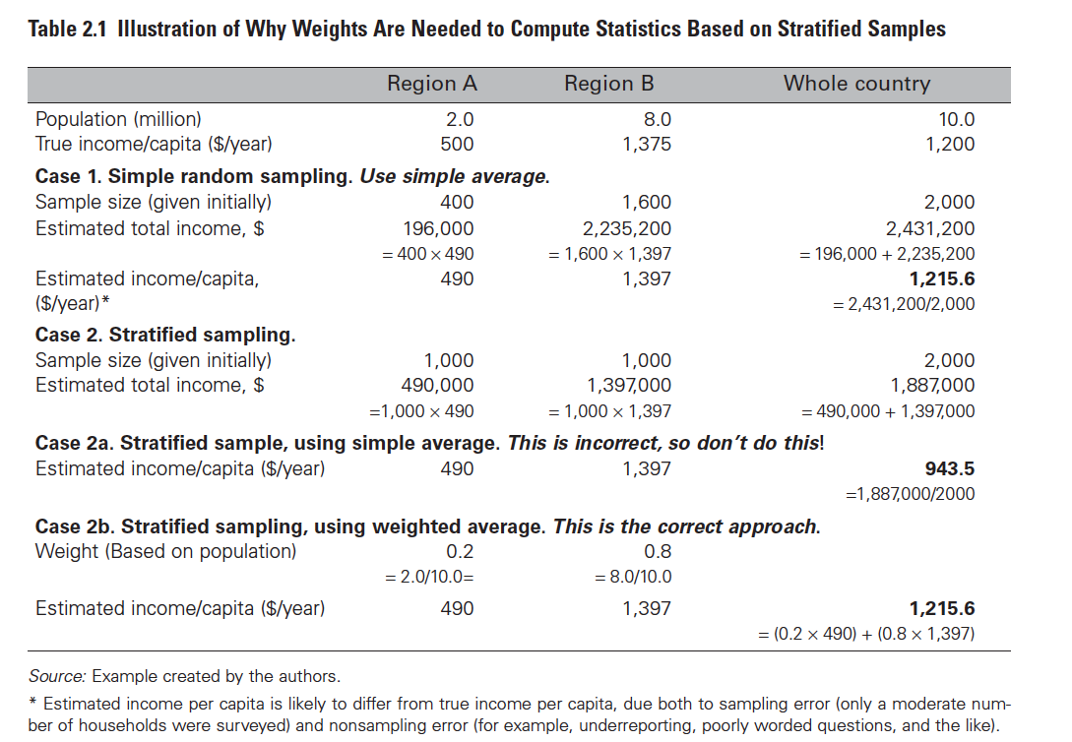

Slide 24
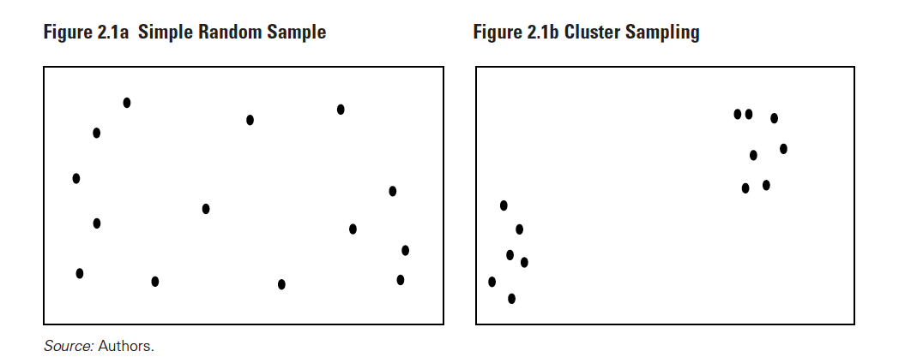

Slide 25
Goods coverage and evaluation
It has been widely observed that the more detailed the questions about income and expenditure, the higher are the reported levels of income and expenditure.
Such in-kind income/expenditure will typically have to be valued at local prices.
It is also essential to collect enough information on housing (rent or current capital value if the household owns its residence), and the main durable goods (age,purchase price, current value), in order to be able to quantify these important components of expenditure and income.

Slide 26
Variability and the time period of measurement
Income and consumption vary from month to month, year to year, and over a lifetime. But income typically varies more significantly than consumption.
In less-developed countries, most analysts prefer to use current consumption than current income as an indicator of living standards in poor countries
This does not mean that consumption is a perfect measure of well-being!!!!

Slide 27
Comparisons across Households at similar consumption level
Households vary not only in their income or expenditure levels, but
in size,
in the prices they face,
in the publicly provided goods (such as roads and schools) to which they have access,
in the amount of leisure time they enjoy,
and in the agreeableness of the environment in which they live (some areas are too hot or too cold or too dry or too flood-prone).

Slide 28
….corrections
Easy to correct for differences in the cost of living faced by households, need for Purchasing Power Parities (Lecture by Luigi Biggeri)
Easy to express income or expenditure in per capita (or per adult equivalent) terms
Difficult to assess the value of publicly provided goods and services

Slide 29
References
Haughton J and Khandker S R (2009) Handbook on poverty and Inequalities, The World Bank, Washington DC
R.M. Groves (2004) Survey Errors and Survey Costs, Wiley, New York
R.M. Groves, Fowler F.J, Couper M. et others (2004) Survey methodology, Wiley New York
Valliant R., Dever J.A, Kreuter F. (2014) Practical Tools for designing and weighting survey samples, Springer New York, Heidelberg

Slide 30
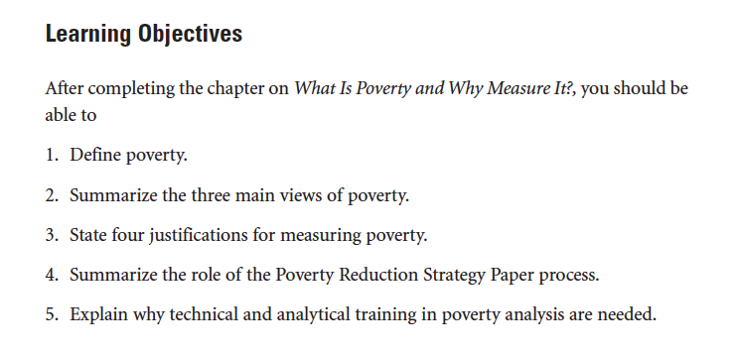

Slide 31
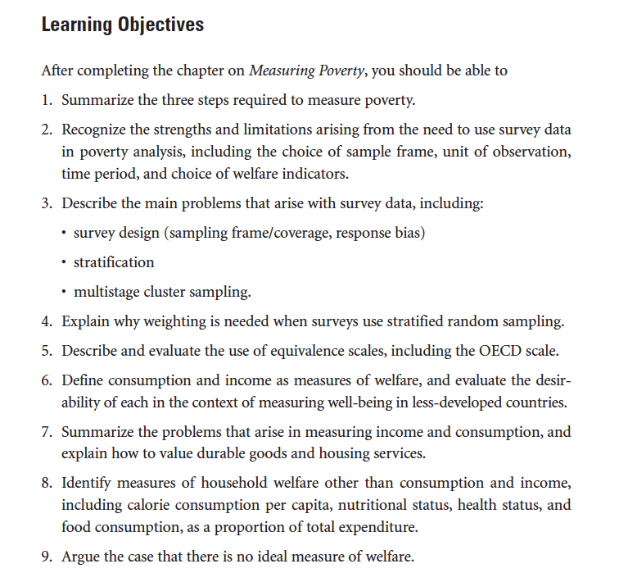

Slide 32
