Slide 1
Purchasing Power Parities of Currencies and Real Expenditures – The International Comparison Program (ICP)
D.S. Prasada Rao
The University of Queensland

Slide 2


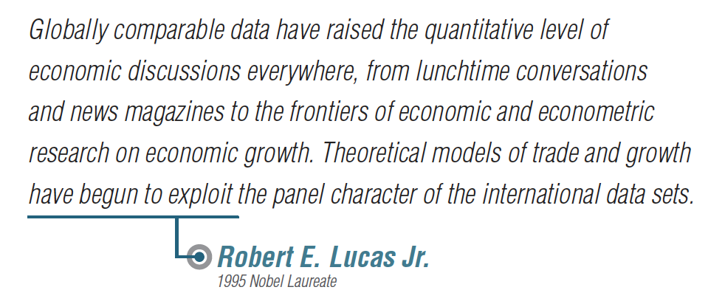

Slide 3


Slide 4
Measuring and comparing Social Welfare
Consider an economy with n individuals with incomes (y₁,y₂,. . .,y_{n})
Welfare in this economy is represented by:
Sen (1976) has shown that, under some very basic axioms, social welfare can be measured using
where μ is per capita income and G is the Gini coefficient (a measure of inequality)
Comparisons of welfare over time for a given country
  We use per capita income μ at constant prices or real per capita income
  Nominal incomes are deflated using a temporal price index
Comparisons of welfare across countries
  Per capita incomes in different countries are expressed in different currency units
  Need to convert incomes into a common currency unit and also adjust for differences in price levels across countries.
    Market exchange rates convert currencies into a common currency unit (e.g. US dollar) but not adjust for differences in price levels
    Purchasing power parities (PPPs) of currencies facilitate both currency conversion and adjustment for price level differences

Slide 5
Purchasing Power Parities (PPPs)
PPPs are amounts of currencies, of different countries, that have the same purchasing power as one unit of a reference currency (e.g. US$) with respect to a selected basket of goods and services.

Slide 6
PPPs - some celebrated examples
Big Mac Index
PPPs from the International Comparison Program – World Bank, OECD, EUROSTAT
Agricultural Sector PPPs – FAO, UN
Manufacturing Sector PPPs - Groningen
Poverty specific PPPs for Global and Regional Poverty Measurement – World Bank

Slide 7

Big Mac PPPs
Italy 3.85 0.726 0.82

Slide 8
PPPs - basic uses
PPPs are essentially spatial price index numbers – interregional comparisons
PPPs are used for real income comparisons
  WDI and HDI; regional and global inequality
Growth and convergence studies
  Necessary to have panels of real incomes – nominal incomes adjusted for temporal and spatial price differences
Growth and productivity studies
  Computing TFP measures, decomposition to technical change and efficiency change
  Extensively used in KLEMS project
PPPs are used by researchers, industries and international organisations for cross-country analyses

Slide 9
PPPs – Main Sources
International Comparison Program
  Started as a research project at the Univ. of Penn in 1968
  Several phases under the auspices of the UN Stat. Office
  OECD and Eurostat regional programs
  2005, 2011 and 2017 (nearing completion) ICP under UN Statistical Commission
    World Bank as the Global Office
    Participation of regional agencies (ADB, AFDB, OECD, Eurostat, etc.)
  ICP Book, World Bank (2013) is a good source for details on the methodology behind the ICP
ICP 2011
  Coverage – 199 economies (including 22 Pacific Island economies)
  A major international statistical initiative under the UN and the World Bank.
  Regional Approach – Asia-Pacific, Africa, OECD-Eurostat, CIS, Western Asia, Latin America and the Caribbean
  Linking regional results by the Global Office at the World Bank
  Results available at the GDP level and for components – Consumption, Investment, Government expenditure, 26 detailed categories
  Results released in April and final released end October, 2014.
Penn World Tables (PWT) 7.1; 9.0 – Panel of PPPs and real incomes; other sources including WDI and UQICD

Slide 10
PPPs from ICP 2011
(selected countries)
Country | Exch. Rate US$ | PPP | PLI% (World=100)
P.R. China Hong Kong India Australia Italy Luxembourg Ethiopia Austria | 6.461 7.784 46.67 0.969 0.719 0.719 16.899 0.719 | 3.506 5.462 15.109 1.511 0.768 0.906 4.919 0.830 | 70.0 90.5 41.7 201 137.7 162.4 37.5 148.8
Source: World Bank, 2014, Results from ICP 2011.

Slide 11
ICP 2011: 12 Largest Economies in 2011
Ranking by GDP (PPP-based) | Economy | Share of world GDP (PPP-based, world = 100) | Share of world GDP (exchange rate–based, world = 100) | Ranking by GDP per capita (PPP-based)
1 | United States | 17.1 | 22.1 | 12
2 | China | 14.9 | 10.4 | 99
3 | India | 6.4 | 2.7 | 127
4 | Japan | 4.8 | 8.4 | 33
5 | Germany | 3.7 | 5.2 | 24
6 | Russia | 3.5 | 2.7 | 55
7 | Brazil | 3.1 | 3.5 | 80
8 | France | 2.6 | 4.0 | 30
9 | United Kingdom | 2.4 | 3.5 | 32
10 | Indonesia | 2.3 | 1.2 | 107
11 | Italy | 2.3 | 3.1 | 34
12 | Mexico | 2.1 | 1.7 | 72
Source: World Bank, Results from ICP 2011.

Slide 12
Ranking of economies by real per capita GDP and Price levels
Ranking by GDP PLI | Economy | GDP PLI (world = 100) | GDP PLI (US = 100) | Ranking by GDP (PPP-based, per capita)
1 | Switzerland | 209.6 | 162.6 | 10
2 | Norway | 206.4 | 160.0 | 7
3 | Bermuda | 201.6 | 156.4 | 9
4 | Australia | 201.0 | 155.9 | 20
5 | Denmark | 185.0 | 143.5 | 21
6 | Sweden | 175.1 | 135.8 | 22
7 | Japan | 173.6 | 134.6 | 33
8 | Finland | 162.6 | 126.1 | 28
9 | Luxembourg | 162.4 | 126.0 | 3
10 | Canada | 161.9 | 125.6 | 23
168 | Cambodia | 42.8 | 33.2 | 146
169 | Uganda | 42.6 | 33.0 | 156
170 | Vietnam | 42.2 | 32.7 | 128
171 | India | 41.7 | 32.4 | 127
172 | Bangladesh | 40.3 | 31.2 | 144
173 | Lao PDR | 39.6 | 30.7 | 133
174 | Ethiopia | 37.5 | 29.1 | 169
175 | Myanmar | 37.0 | 28.7 | 139
176 | Pakistan | 36.4 | 28.2 | 129
177 | Egypt | 35.1 | 27.2 | 97
Source: World Bank, Results from ICP 2011.

Slide 13
ICP 2011: Regional GDP Shares
Source: World Bank, Results from ICP 2011.

Slide 14
Global Distribution of Income: 2005, 2011
Source: World Bank, Results from ICP 2005 and 2011.

Slide 15
Per capita GDP in PPP terms (1990 dollars)
Source: Series from Maddison Project, GGDC

Slide 16
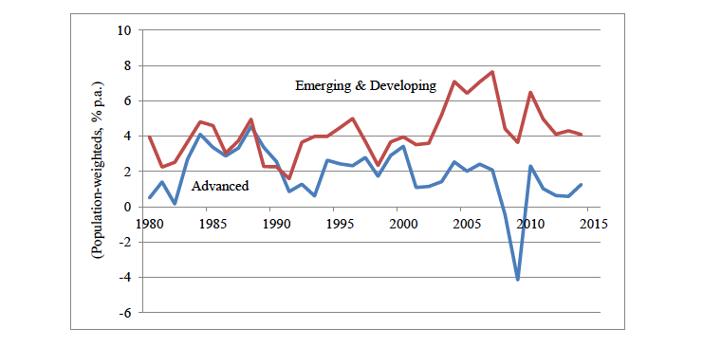
Real per capita GDP Growth in advanced economies and emerging developing economies, 1980-2014
Source: Zia Qureshi, 2017

Slide 17
Three types of inequality
Type 1: Inter-country inequality
  Inequality in real per capita income
  Each country is treated as one individual
  Decomposition into within-region and between-region inequality
Type 2: International inequality
  Inequality measure which is based on the use of population weights
  Each country is represented by the population size and average incomes
Type 3: World or Global inequality
  A more complete measure that takes into account per capita income, population size and inequality within each country
  The first and second types ignore “inequality within each country”
These three measures of inequality are based on real per capita incomes – incomes converted using PPPs

Slide 18
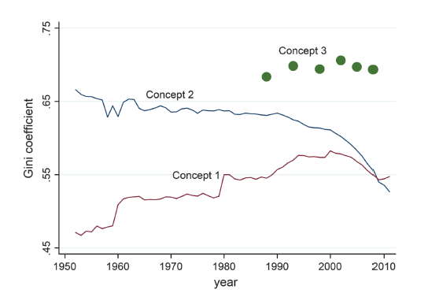
Trends in inequality: Concepts 1, 2 and 3
Source: Milanovic 2013, 2016

Slide 19
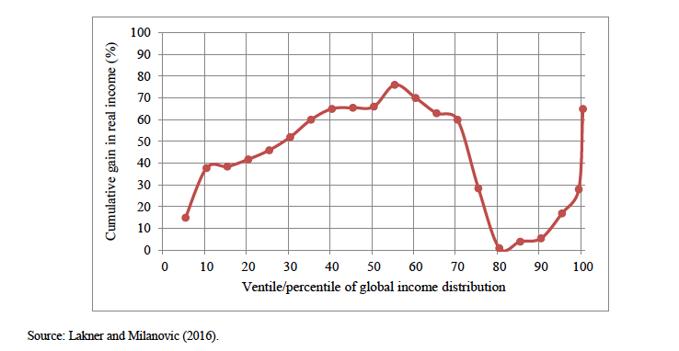
Relative gain in real per capita income by global income level, 1998-2008

Slide 20
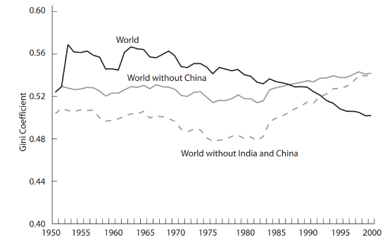
Global inequality: China and India
Source: Milanovic, 2005

Slide 21
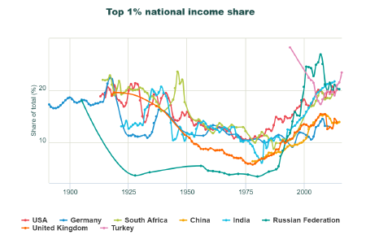
Trends in income shares of the rich, 1900-2010
Source: www.WID.world

Slide 22
Global and regional poverty estimates
$1.90 poverty line based on 2011 ICP PPPs
These estimates are based on the recommendation of the Atkinson Commission Report in 2016 that $1.90 poverty line based on 2011 ICP be fixed and extrapolated forwards and backwards using domestic CPI. Resulting estimates are:
Source: World Bank website, 2017

Slide 23
PPP Measurement and the International Comparison Program
Notes:
The geometric lag has the advantage of being relatively simple. But there are many instances where it is unreasonable to assume that the first lag weight is the largest (e.g., the inflation example).

Slide 24
Overview of ICP
What is the ICP?
A worldwide statistical initiative to collect comparative price data and estimate purchasing power parities (PPPs) of the world’s economies
Why PPPs?
Exchange rate–converted GDPs can be misleading on the relative sizes of economies and levels of material well-being mainly due to large differences in price levels across the countries
PPPs make it possible to compare the output of economies and the welfare of their inhabitants in real terms as they are both currency converters and spatial price deflators
Main Objectives
Provide international price and volume comparisons of GDP and its expenditure aggregates
Between countries within a region
Between countries across the regions

Slide 25
ICP Workflow
Country
Statistical
Offices
Computation of regional results
ICP Secretariat
(World Bank)
Price collection and expenditure data compilation
Regional Implementing Agencies
Linking regional results to produce global results

Slide 26
ICP/PPP Data Requirements
Price data requirements
  National annual average prices for household consumption items - for example, “white rice” under basic heading “Rice”
    Approx. 620 global core list products
    Supplemented with additional approx. 1000 region-specific products
Price data for special surveys covering other GDP components: Housing; private education; government compensation; machinery and equipment; and construction
  Price data must be consistent with national accounts measurements
National accounts expenditure data requirements
National accounts expenditures for 155 headings

Slide 27
ICP/PPP Key Concepts
Product characteristics
Representative/importance: products prices reflect purchases in the region/country
Comparability: products are sufficiently similar (and well-defined) for inter-country comparisons
Expenditure characteristics
Conform to System of National Accounts concepts , definitions and valuation methods
Reflect total volumes of transactions for goods and services in the country

Slide 28
ICP Classification
Expenditure Levels
Gross Domestic Product
7 Main Aggregates
Individual consumption by households
Individual consumption by government
Gross fixed capital formation
Published
Food & Non-Alcoholic
Beverages
Alcoholic Beverages & Tobacco
26 Categories
Alcoholic Beverages & Tobacco
Food
61 Groups
Food
Non-Alcoholic Beverages
Unpublished
Bread & Cereals
Meat
Fish
126 Classes
Bread & Cereals
Meat
Fish
155 Basic Headings
Rice
Bread
Pasta

Slide 29
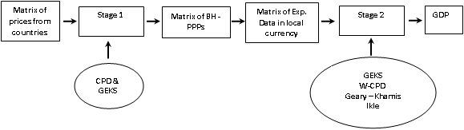
ICP within a region : A Schematic Diagram

Slide 30
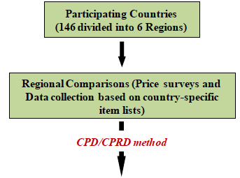
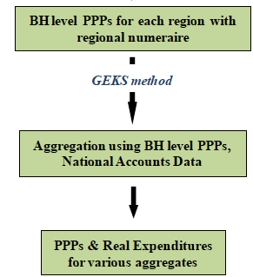
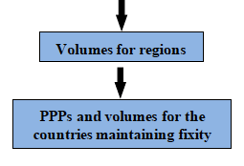
ICP 2011 - Framework
Global linking
Global Core prices
Linking Factors
Productivity Adjustment
GEKS for the whole world
Fixity
Country Aggregation and Redistribution (CAR) method

Slide 31
Global Linking using the Country Aggregation and Redistribution (CAR) Method (ICP 2011)
Global Linking is a task undertaken by the Global Office or Unit at the World Bank.
All the participating countries are used in the linking process.
  This is different from the process used in 2005 where 18 ring countries were used.
“Fixity” principle is strictly adhered to
  Relative sizes of countries within a region established by regional comparisons are maintained in the global comparisons.
Linking is done at the basic heading level and then used in the aggregation above basic heading level.

Slide 32
Linking at the Basic Heading level
A core list of products is established by the Global Office.
  Core list is prepared using the regional lists
  Balance between comparability and representativity is taken seriously
Prices of items in the core list are collected in all the countries (in all regions) and supplied to the Global Office
  Not all items are priced in all the countries
Prices of items in the basic heading in countries within a particular region are all converted into the currency of the reference country within the region.
  For example, prices in the Asia-Pacific region are all converted into Hong Kong dollars
The country-product-dummy (CPD) method is used on these converted price from all regions.
  Using US dollar (from OECD region) as the reference currency, linking factors are computed for all the regional reference currencies.
  These linking factors measure the parity between US dollar and Hong Kong dollar and currencies of other regions.

Slide 33
Making Global Price and Real Income Comparisons
Linking factors are used to convert BH parities within each region into the global reference currency – US dollar
  We have a matrix of BH parities for 155 Basic Headings and 177 participating countries
  A matrix of expenditures, in national currency units, at the basic heading level is also available.
A global comparison is made using linked BH PPPs and national expenditure data.
  In the ICP the GEKS (Gini-Elteto-Koves-Szulc) method used. Geary-Khamis and weighted CPD can also be used.
Using global PPPs, GDPs of all the countries are all converted and regional total GDP is computed for each region.
Regional GDP totals are redistributed to countries within the region using their shares in regional comparison.
  Real GDP for each country in each region is computed.
  PPPs are computed as the ratio of GDP in national currency to GDP in US dollars

Slide 34
Index Number Methods for computing PPPs
Notes:
The geometric lag has the advantage of being relatively simple. But there are many instances where it is unreasonable to assume that the first lag weight is the largest (e.g., the inflation example).

Slide 35
Multilateral Comparisons - Data

Slide 36
Index numbers for Bilateral Comparisons
Three important index numbers:
Laspeyres Index:
Paasche Index:
Fisher Index:
Fisher Index is known as the Fisher Ideal Index Number

Slide 37
Multilateral Price and Quantity Comparisons
In the case of spatial or international comparisons, typically comparisons between all pairs of countries (regions) are required.
    This may not be the case in temporal comparisons where time progresses in one direction – leading to chained indexes.
Let P_{jk} and Q_{jk} represent price and quantity indexes for country k with country j as base or reference country.

Slide 38
Transitivity Requirement
Transitivity – This is an internal consistency requirement which states that direct price or quantity comparisons between pairs of countries should equal any indirect comparisons between the two countries obtained through a link country.
A formal statement of transitivity is that for any three countries
the price and quantity indices must satisfy
We will examine the implications of transitivity to international price and quantity comparisons.

Slide 39
Transitivity of price comparisons - implications
Transitivity of price comparisons requires:
Result: A matrix of multilateral price comparisons satisfies transitivity if and only if there exist a set of numbers such that:
We note here that the π’s are determined up to a factor of proportionality this means that if is a solution then
is also a solution.
In this case we normalize the solution by typically one of the π’s is set at 1. Let π_{M} = 1. This means that currency of country M is used as reference currency.
When π_{M} is set to 1, then each π is interpreted as PPP and we have

Slide 40
Gini-Elteto-Koves-Szulc (GEKS) and weighted GEKS methods for aggregation below and above basic heading level

Slide 41
Gini-Elteto-Koves-Szulc Method
This method was previously known as the Elteto-Koves-Szulc (EKS) method which proposed in 1964.
The EKS method was the preferred method of aggregation below and above the basic heading level in the EU region.
A decade ago it was discovered that Gini proposed a similar method in 1924 and also mentioned in his work in 1931, “On the Circular Test of Index Numbers” published in the International Review of Statistics.
    It has since then been referred to as the GEKS method
Since the 2005 round of the ICP, GEKS has been the recommended method for aggregation above the basic heading level.
It is only recently a generalization known as the weighted GEKS has been proposed and discussed.

Slide 42
Gini-Elteto-Koves-Szulc Method
The GEKS method is anchored on the following ideas:
    For international comparisons we need the complete matrix of comparisons (Price or Quantity)
    Binary methods like the Fisher and Tornqvist indexes are best for making binary comparisons or any pairs of countries
    Most binary methods to not satisfy transitivity
    It is important to maintain characteristicity – transitive multilateral comparisons must be close to the binary indexes to the extent possible.
Suppose we start with a matrix of binary price comparisons
Note that no particular formula is mentioned here even though the original EKS method was defined on Fisher binary indexese

Slide 43
Gini-Elteto-Koves-Szulc Method
The GEKS method suggests that we look for a price index which is transitive which deviates from the observed price index the least.
    Let us start with the observed price index, .
    GEKS method finds which is transitive and is also closest to .
    This can be done by solving the following problem:
We recall that transitivity of means that there exist numbers
Minimise
subject to:

Slide 44
Gini-Elteto-Koves-Szulc Method
Substituting
we have the following problem
Taking the first order conditions and solving for the π ‘s , it can be shown that
Note here that the EKS formula can be applied to any index number formula we choose – the formula must satisfy time or country reversal test.
Minimise

Slide 45
GEKS Method - interpretation
The GEKS formula
can be given simple interpretation.
Since the original index P_{jk} is not transitive, we get a different answer for each indirect comparison shown above. So, for a comparison between two countries j and k, we have M indirect comparisons. Since all countries are treated symmetrically, we take geometric average (to attain transitivity) of the indirect comparisons

Slide 46
GEKS Method - interpretation
Another interpretation is that the GEKS comparison is a geometric average of the set of all star comparisons.
A “star” comparison is where comparisons between any two countries is obtained through the star country.
All comparison are through USA
For any pair of countries, say Germany and Egypt, comparison will depend on the “star” country selected. This means we get M different comparisons based on different stars.
GEKS simply uses the geometric mean of all such star comparisons
India
China
Germany
Ghana
USA
Egypt
Brazil

Slide 47
GEKS and below Basic heading Level aggregation
In this case only price data are available and no expenditure data are available. The price tableau is given by:
We consider three cases:
  Price tableau is complete – all items are priced in all countries
  Price tableau is incomplete – not all items are priced in all countries
    Out of the goods prices, each country designates a certain number of commodities as important/representative
 | country 1 | Country 2 | …… | Country M
Commodity 1 | p₁₁ | p₁₂ | p_{1j} | p_{1M}
Commodity 2 | p₂₁
……
…… |  |  | p_{ij}
Commodity N | p_{N1} | p_{N2} | p_{Nj} | p_{NM}

Slide 48
GEKS and below Basic heading Level aggregation
Price Tableau is complete: All commodities are priced in all countries. Then the price index used is the Jevons index.
In this case the index is already transitive.
Price Tableau is incomplete: In this case, only prices of goods which are available in both countries can be used.
Note that this index is not transitive. Then we use GEKS to compute a transitive index.

Slide 49
GEKS and below Basic heading Level aggregation
Price Tableau is incomplete and countries indicate which the importance and representativeness of commodities.
n_{j} = represents the set of representative commodities in country j also priced in k.
n_{k} = represents the set of representative commodities in country k also priced in j.
Then the comparison between the two countries is the geometric average of these two indices – is similar in spirit to Fisher index
Note that this index is not transitive – we use GEKS to provide transitive indices.

Slide 50
GEKS above Basic heading Level aggregation
In this case we have the two following points to note:
    Price data are available for all the countries and commodities
    Quantities are non-negative.
In this case we can make use of Fisher or Tornqvist index to make binary comparisons to obtain GEKS indices.
Fisher based GEKS: This is the original EKS method
Tornqvist based GEKS – this is also known as the Caves, Christensen and Diewert (CCD) index proposed in 1982

Slide 51
Weighted GEKS Method
The main philosophy behind GEKS is that:
  Direct comparison is the best comparison between any two countries
  GEKS then produces transitive comparisons that are closest to the matrix of binary comparisons.
We note here that not all binary comparisons are of same quality. Reliability of binary comparisons may depend upon many considerations.
  Reliability at the basic heading level will depend upon the number of items that are commonly priced
  Reliability may depend upon how many representative products of one country are priced in the other country
  Countries may be at different levels of development
    Price structures may be dissimilar
    Quantity structures may be dissimilar
  Countries are of dissimilar sizes
This means that some link comparisons should be given less weight than some others OR some binary comparisons should be considered less important in making transitive comparisons

Slide 52
Weighted GEKS Method
The Weighted GEKS method described in Rao (2009) makes use of the regression specification to account for different levels of reliability associated with the binary comparisons. The regression specification is:
where w_{jk} can be regarded as a measure of reliability. If w_{jk} is large then the particular binary comparison is more reliable and the error term has a lower variance.
Parameters of this model can be estimated by applying generalized least squares or apply ordinary least squares to the following transformed model:

Slide 53
Weighted GEKS Method
The Weighted GEKS indices can be obtained by solving the following normal equations:
This system can be solved only after imposing one restriction. We can use the normalization
This approach of weighted GEKS includes the suggestion made in Balk (2009) by simply using:
where f_{j} represents a scale factor that may reflect the size of the economy.

Slide 54
Summary
Most desirable binary indices do not satisfy transitivity and base invariance.
GEKS is a method that produces “transitive” comparisons from “non-transitive” comparisons while maintaining “characteristicity”.
We provide three different interpretations of GEKS indexes.
We offer a regression based interpretation to GEKS which can be used in producing generalized or weighted GEKS.
GEKS indices for comparisons below basic heading level are described.
GEKS based on Fisher and Tornqvist binary indices for aggregation above basic heading level are given.
Weighted GEKS with different sets of weights are discussed for
      Below basic heading level
      Above basic heading level
Numerical illustration based on OECD data are shown.

Slide 55
The Country-Product-Dummy (CPD) Method

Slide 56
History of Stochastic Approach
Carli Index (1764) - arithmetic average of price relatives
Jevons (1863, 1865 and 1869) – geometric mean of price relatives
Edgeworth (1887-1889, 1925) – confidence intervals for Carli and Jevons indices, weights
Bowley (1901) – precision of weighted index numbers
Frisch (1936) – A review article in Econometrica which includes reference to stochastic approach
Theil (1965, 1973 and 1974)
    information theoretic approach
    Log-change index numbers
Summers (1973) – basic CPD model and filling gaps in data
Balk (1980) – CPD model for seasonal adjustment

Slide 57
Country-product-dummy method
CPD Method – Summers (1973)
    Proposed as a method of filling gaps in price data
    A method of computing PPPs below the basic heading level
    The CPD method has always been used as a method of aggregation below basic heading level.
Recent interest on CPD Method
    Work of Rao (1995, 2005) has established a formal link between the weighted version of CPD and the Rao index for aggregation above basic heading level
    Aten and Menezes (2002) used this method to compute sub-national PPPs for Brazil
    Various versions of the weighted CPD have been used by Ray, Coondoo, Majumdar and Sinha (2004, 2012, 2013 and 2014)
    Diewert (2002) has shown how the CPD model can be used in handling transactions level data
    Diewert (2005) has shown how the CPD model can be used in deriving some binary indexes

Slide 58
Notation
M countries and N commodities
observed price of the i-th commodity in the j-th country
quantity of the i-th commodity in the j-th country
purchasing power parity of j-th country
Average price for i-th commodity
Expenditure shares
Weights based on expenditure shares
When M = 2, we have the case of binary comparisons.

Slide 59
The Law of One Price
Following Summers (1973), Rao (2005) and Diewert (2005) we consider
Price of i-th commodity
in country j
Purchasing Power Parity of
Currency j
World price of i-th commodity
Random disturbance term
Sotchastic term
The CPD model may be considered as a “hedonic regression model” where the only characteristics considered are the “country” and the “commodity”.

Slide 60
Basic CPD Model
Multiplicative Model:
Additive Model:
Purchasing Power Parities:
International Comparison Program (ICP):
  PPPs at the basic heading level (elementary indices)
  PPPs for GDP and sub-aggregates

Slide 61
CPD Model
Let us consider the CPD model:
This can be expressed in the format of a simple regression model with dummy variables for countries and commodities – hence the name: country-product-dummy (CPD) method

Slide 62
Estimation of the CPD Model
Let us consider the CPD regression model for I =1,2,…,N and j=1,2,…,M
This model can be written in the form of a standard regression model:
We can apply ordinary least squares to estimate parameters.

Slide 63
Price comparisons from CPD Model
We consider two cases: (i) complete tableau; (ii) incomplete tableau
In either case the least squares estimator is given by:
We note that in this case the matrix X’X is singular – because of the dummy variables for commodities and countries. So we can derive estimator only after setting one of the parameters is equal to one.
In the case of complete tableau, the estimates lead to the following price comparison between countries

Slide 64
Gini-Elteto-Koves-Szulc (GEKS) Method
GEKS index without weights: Aggregation below basic heading level
Complete Price Data
Incomplete Price Data
GEKS index:
Now we consider the CPD model with and without complete data

Slide 65
CPD price comparisons - continued
Standard properties of least squares estimators hold for
Exp ( ) is not an unbiased estimator of PPP_{j}
Under lognormality of residuals of the multiplicative model, it is possible to derive UMVUE of PPP_{j}.
Estimated standard errors can be calculated for estimator of PPP_{j} without any distributional assumptions
When price tableau is complete, standard errors of are the same for all c; however, they vary for estimators of PPP’s.
With complete price data, the CPD estimator of PPPs is identical to the GEKS PPPs – both methods give the same answer
When price tableau is incomplete, the CPD estimator makes use of all the information that is available.
      If a commodity is priced in only country that information will not be used in the model

Slide 66
CPD price comparisons - continued
If the disturbances in the original CPD model are log-normal, then the disturbances in the regression model, v_{ij} , are normally distributed.
This means that we can use standard t-tests and confidence intervals for the PPPs.
The regression approach minimizes the residual sum of squares:
In this case all the price observations are given equal weight.
However if there is additional information available on weights in the form of expenditure shares or importance then we can minimize weighted sum of squares
The current recommendation is to give weight 3 if the product is important and 1 if it is not important. Question is what weights to give?
We are currently using scanner data to determine weights for items that are considered important.

Slide 67
CPD with incomplete price data
In ICP, countries within a region are all given a list of products with well specified product characteristics for purposes of price collection.
Price tableau is usually incomplete – can be quite sparse.
The CPD model can be applied to the incomplete price data provided data are not too sparse.
The paper states a few conditions under which the CPD regression model can provide estimates of all the parameters when one linear restriction is imposed.
A necessary and sufficient condition for the CPD model to work is that the “graph” associated with the price data is connected.
The extent of sparseness influences the standard errors.

Slide 68
CPD with incomplete price data
Role of CPD as a filler of missing price data
  Once the CPD model is estimated with available data, it can be used in filling gaps with predicted prices – original idea of Summers (1973).
  Once the price tableau is complete after filling gaps, it is possible to use GEKS on the full data set.
  Rao (2004) showed that the GEKS PPPs derived using CPD fillers are identical to the PPPs estimated from the CPD model on incomplete data.
  This follows from the fact that the regression estimates do not change if we augment price tableau with predictions from the GCPD – no free lunch!
  However, GEKS applied on incomplete data and GEKS applied to filled data differ – this means CPD is superior to GEKS

Slide 69
CPD Model above basic heading level.
We consider the same CPD model and its regression model:
For aggregation above the basic heading level, we have 155 basic headings at GDP level. This means that M =155.
Price data are available, in the form of basic heading PPPs or reference PPPs, for all the basic headings.
We also have expenditure and, therefore quantity data available for each commodity in each country. Some expenditures may be zero.
This means that we have measures of importance of each item in the form of expenditure share weights.
We can use weighted least squares method or weighted CPD

Slide 70
Weighted CPD for above basic heading level comparisons
When expenditure data are available, we can use expenditure shares as weights. This means that we can minimize weighted sum of squares:
or in matrix form we minimize:
We can obtain weighted least squares estimator after fixing one of the π’s equal to zero.
The normal equations of the weight least squares procedure are given in the next slide

Slide 71


Equivalence of Weighted CPD and Rao method
It is quite easy to show that minimize weighted sum of squares:
with respect to the unknown parameters leads to the following system of normal equations:
If these are written in PPP and P’s, we have
These equations are identical to the equations that determine the Rao (1990) system – this establishes equivalence of the two systems.

Slide 72
CPD Regressions with weights - continued
Use expenditure share weights – this is consistent with Theil (1967) formulation that is consistent with standard index number practice.
  Rao (2005) has shown that the weighted CPD results in PPPs that are identical to those derived from an expenditure-share weighted logarithmic version of the Geary-Khamis method discussed in Rao (1990).
  This result provides a link between the CPD and some standard aggregation methods used in the ICP.
  When M=2, the resulting PPP can be shown to be a weighted geometric average of prices with harmonic mean of the weights of the two countries.
  This link has resulted in an increased use of the weighted CPD for purposes of PPP computation (Aten and Menezies, 2002, Rao, 2003 and Deaton, 2004, Diewert, 2005, Hajargasht and Rao, 2010).

Slide 73
CPD Regressions with weights - continued
The weighted CPD regressions can be run using standard regression packages or some analytical expressions can be derived in simple cases.
It is important the variance covariance matrix is properly computed. Since the starting assumption is that , the covariance matrix is given by:
This is known as “sandwich” estimator
Care should be taken if a regression package is used where the standard calculation is automated to standard assumptions.
The use of weighted least squares is very similar to the use of M-estimators discussed in Davidson and Mackinnon (1993).

Slide 74
CPD Method – other properties
  Diewert (2004) discusses a CPD model where multiple price quotations are available for a product in a given country – in this case there is more information than just what average price provides.
  In the presence of price quotations, it is possible to extend the CPD model to estimate rural-urban or outlet based PPPs.
  Diewert (2004) describes how the CPD method can be used in deriving country-specific and regional PPPs in a single-step.
  Aizcorbe and Aten (2004) consider time-country dummies to derive time-space comparisons. Ray, Majumdarand Sinha (2014) applied this procedure for spatial temporal comparisons involving regions of India, Indonesia and Vietnam

Slide 75

CPD Method – other properties
  It is possible to extend the method to incorporate quality characteristics – this would be useful in comparing rental prices and prices of electronic goods and services
  where Z_{q}’s are quality characteristics.
  The CPD model can be used to derive the “old” stochastic approach of Rao and Selvanathan. Consider the CPD model for countries j and k
  The CPD model can be used to derive:
        Dutot, Carli and Jevons indices for below basic heading level
        Ikle, Geary-Khamis, Rao and a new indices for above basic heading level
        See Rao and Hajargasht (2016)

Slide 76
Notation
M countries and N commodities
observed price of the i-th commodity in the j-th country
quantity of the i-th commodity in the j-th country
purchasing power parity of j-th country
Average price for i-th commodity
Expenditure shares
Weights based on expenditure shares
When M = 2, we have the case of binary comparisons.

Slide 77
Geary-Khamis System of equations
The Geary-Khamis system provides a set of interdependent equations that define and international prices ,
Given the values of , the GK system defines each international average price as:
Given the values of , the GK system defines PPP of currency of a country as:

Slide 78
Rao-multilateral system
This is one of the first extensions of the Geary-Khamis system. The new system replaces the arithmetic average by geometric average in defining PPPs for each country as:
The international prices P_{i} are defined in a radically different manner from the G-K method.
Two reasons behind this approach:
  Value shares are likely to be more similar across countries compared to quantity shares.
  Value shares are size neutral and address one of the main criticisms of GK method.

Slide 79
Ikle - system
Ikle (1972) proposed a system for making international price and quantity comparisons.
The initial version of (1972) was difficult to interpret and was largely neglected until Dikhanov (1994, 1997) provided a simpler expression for the index.
The Ikle system is given by:
We can see that the Ikle system is an additive system.
The international average prices defined here use the same weighting system as in Rao but use Harmonic Mean of the prices converted into a common currency unit using PPPs.
Diewert (2013) provides a proof of the existence of the solution for the Ikle system.
No explicit solution can be derived even in the special case M=2.

Slide 80
Geary-Khamis Method Allowing For substitution possibilities
There has been a lot of work on modifying the G-K system to allow for substitution possibilities in defining purchasing power parities.
One of the earliest attempts is due to Rao (1976) and Rao and Coondoo (1984). Here the definition of “international average price” is the same as that in GK system.
But purchasing power parity of currency of country j is defined as:
Note that we have a highly non-linear system of equations.
Rao (1976) proved the existence of positive solutions that are unique up to a factor of proportionality.

Slide 81
Neary (2004) proposal for International comparisons
Neary (2004) calls this method the Geary-Allen Inernational Accounts (GAIA).
Neary uses the same definition for PPPs as Rao (1976)
but explicitly uses the optimal quantities associated with the solution for the cost minimization problem.
Neary (2004) modifies the Geary-Khamis definition of international average price.
Proving the existence of solutions to all these highly non-linear systems is challenging. In Hajargasht and Rao, “Multilateral Index Number systems for International Comparisons: Properties, Existence and Uniqueness” (To appear in JME) we obtain necessary and sufficient conditions.

Slide 82
Reliability of PPPs from the International Comparison Program
Notes:
The geometric lag has the advantage of being relatively simple. But there are many instances where it is unreasonable to assume that the first lag weight is the largest (e.g., the inflation example).

Slide 83
Sensitivity Global and Regional Poverty Estimates
to changes in PPPs
International Poverty Line = $1.90; Year = 2011

